Slide 1
Kubernetes – portable, extensible open-source platform

Slide 2
Introduction
Kubernetes is a portable, extensible open-source platform for managing containerized workloads and services, that facilitates both declarative configuration and automation. It has a large, rapidly growing ecosystem. Kubernetes services, support, and tools are widely available.
Google open-sourced the Kubernetes project in 2014. Kubernetes builds upon a decade and a half of experience that Google has with running production workloads at scale, combined with best-of-breed ideas and practices from the community.

Slide 3
What Kubernetes can do for you?
With modern web services, users expect applications to be available 24/7, and developers expect to deploy new versions of those applications several times a day. Containerization helps package software to serve these goals, enabling applications to be released and updated in an easy and fast way without downtime.
Kubernetes helps you make sure those containerized applications run where and when you want, and helps them find the resources and tools they need to work.
Kubernetes is a production-ready, open source platform designed with Google's accumulated experience in container orchestration, combined with best-of-breed ideas from the community.

Slide 4
Features
Kubernetes has a number of features. It can be thought of as:
A container platform
A microservices platform
A portable cloud platform and a lot more.
It orchestrates computing, networking, and storage infrastructure on behalf of user workloads. This provides much of the simplicity of Platform as a Service (PaaS) with the flexibility of Infrastructure as a Service (IaaS), and enables portability across infrastructure providers.

Slide 5
Kubernetes API
The Kubernetes API also serves as the foundation for the declarative configuration schema for the system. The kubectl command-line tool can be used to create, update, delete, and get API objects.
Kubernetes also stores its serialized state in terms of the API resources.
Kubernetes itself is decomposed into multiple components, which interact through its API.
Overall API conventions are described in the : https://github.com/kubernetes/community/blob/master/contributors/devel/api-conventions.md
API endpoints, resource types and samples are described in :
https://kubernetes.io/docs/reference/
Remote access to the API is discussed in the :
https://kubernetes.io/docs/admin/accessing-the-api/

Slide 6
Kubernetes Object
Kubernetes Objects are persistent entities in the Kubernetes system. Kubernetes uses these entities to represent the state of your cluster. Specifically, they can describe:
- What containerized applications are running (and on which nodes)
- The resources available to those applications
- The policies around how those applications behave, such as restart policies, upgrades, and fault-tolerance
A Kubernetes object is a “record of intent”–once you create the object, the Kubernetes system will constantly work to ensure that object exists. By creating an object, you’re effectively telling the Kubernetes system what you want your cluster’s workload to look like; this is your cluster’s desired state.
Notes:
Describing a Kubernetes Object
When you create an object in Kubernetes, you must provide the object spec that describes its desired state, as well as some basic information about the object (such as a name). When you use the Kubernetes API to create the object (either directly or via kubectl), that API request must include that information as JSON in the request body. Most often, you provide the information to kubectl in a .yaml file. kubectl converts the information to JSON when making the API request.
kubectl create -f https://k8s.io/docs/user-guide/nginx-deployment.yaml --record

Slide 7
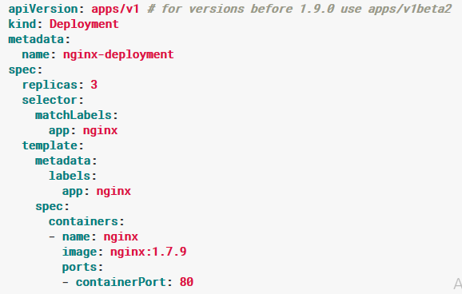
Kubernetes Object : YAML

Slide 8
Kubernetes Object Management : Imperative Commands
When using imperative commands, a user operates directly on live objects in a cluster. The user provides operations to the kubectl command as arguments or flags.
Run an instance of the nginx container by creating a Deployment object:
kubectl run nginx --image nginx
Do the same thing using a different syntax:
kubectl create deployment nginx --image nginx

Slide 9
Kubernetes Object Management : Imperative Object Configuration
In imperative object configuration, the kubectl command specifies the operation (create, replace, etc.), optional flags and at least one file name. The file specified must contain a full definition of the object in YAML or JSON format.
Create the objects defined in a configuration file:
kubectl create -f nginx.yaml
Delete the objects defined in two configuration files:
kubectl delete -f nginx.yaml -f redis.yaml
Update the objects defined in a configuration file by overwriting the live configuration:
kubectl replace -f nginx.yaml

Slide 10
Kubernetes Object Management : Declarative Object Configuration
When using declarative object configuration, a user operates on object configuration files stored locally, however the user does not define the operations to be taken on the files. Create, update, and delete operations are automatically detected per-object by kubectl. This enables working on directories, where different operations might be needed for different objects.
Process all object configuration files in the configs directory, and create or patch the live objects:
kubectl apply -f configs/
Recursively process directories:
kubectl apply -R -f configs/

Slide 11
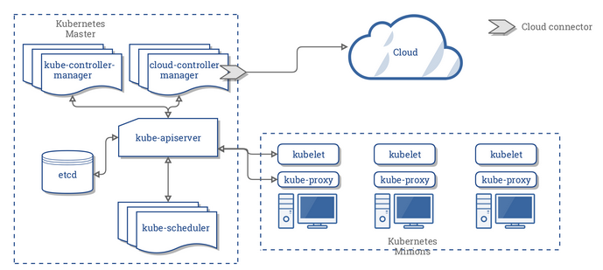
Architecture

Slide 12
Kubernetes Nodes
A node is a worker machine in Kubernetes, previously known as a minion. A node may be a VM or physical machine, depending on the cluster. Each node has the services necessary to run ppds and is managed by the master components. The services on a node include Docker, kubelet and kube-proxy
Notes:
Node status :
Addresses :
HostName: The hostname as reported by the node’s kernel. Can be overridden via the kubelet --hostname-override parameter.
ExternalIP: Typically the IP address of the node that is externally routable (available from outside the cluster).
InternalIP: Typically the IP address of the node that is routable only within the cluster.
Condition
The conditions field describes the status of all Running nodes.
Node Condition Description
OutOfDisk : True if there is insufficient free space on the node for adding new pods, otherwise False
Ready : True if the node is healthy and ready to accept pods, False if the node is not healthy and is not accepting pods, and Unknown if the node controller has not heard from the node in the last 40 seconds
MemoryPressure : True if pressure exists on the node memory – that is, if the node memory is low; otherwise False
DiskPressure : True if pressure exists on the disk size – that is, if the disk capacity is low; otherwise False
NetworkUnavailable : True if the network for the node is not correctly configured, otherwise False ConfigOK True if the kubelet is correctly configured, otherwise False
Capacity
Describes the resources available on the node: CPU, memory and the maximum number of pods that can be scheduled onto the node.
Info
General information about the node, such as kernel version, Kubernetes version (kubelet and kube-proxy version), Docker version (if used), OS name. The information is gathered by Kubelet from the node
"conditions": [ { "type": "Ready", "status": "True" } ]

Slide 13
Kubernetes Master _- Node Communication
There are two primary communication paths from the master (apiserver) to the cluster. The first is from the apiserver to the kubelet process which runs on each node in the cluster. The second is from the apiserver to any node, pod, or service through the apiserver’s proxy functionality.
apiserver -> kubelet
The connections from the apiserver to the kubelet are used for:
Fetching logs for pods.
Attaching (through kubectl) to running pods.
Providing the kubelet’s port-forwarding functionality.
Notes:
These connections terminate at the kubelet’s HTTPS endpoint. By default, the apiserver does not verify the kubelet’s serving certificate, which makes the connection subject to man-in-the-middle attacks, and unsafe to run over untrusted and/or public networks.
To verify this connection, use the --kubelet-certificate-authority flag to provide the apiserver with a root certificate bundle to use to verify the kubelet’s serving certificate.
If that is not possible, use SSH tunneling : between the apiserver and kubelet if required to avoid connecting over an untrusted or public network.
Finally, Kubelet authentication and/or authorization : https://kubernetes.io/docs/admin/kubelet-authentication-authorization/ should be enabled to secure the kubelet API.

Slide 14
Lab : Kubernetes

Slide 15
Thanks!
Any questions?
You can find me at @username & user@mail.me

